Slide 1
Project Benson
MTA Turnstile Ridership Analysis
Group 4
Audrey Baker, Brad Davies, Brad Solomon, Kevin Stern, Will Stokvis
Notes:
BRAD DAVIES:
Names
Group #

Slide 2
Agenda
Overview
Insights
Recommendations
Notes:
BRAD DAVIES: Overview: project objective, executive summary, approach

Slide 3
Overview

Slide 4
Project objective
Optimize street teams at the entrance of subway stations to reach potential attendees and contributors for WTWY’s summer 2018 annual gala
Notes:
Brad Davies:
Mention Q1 2017 – Q1 2018 here.
Gala is in the summer
Attendees: Educated, wealthy, women and people in tech
Making assumption that you want to mobilize your street teams within the next three months (therefore we analyzed Q1 2017 data)

Slide 5
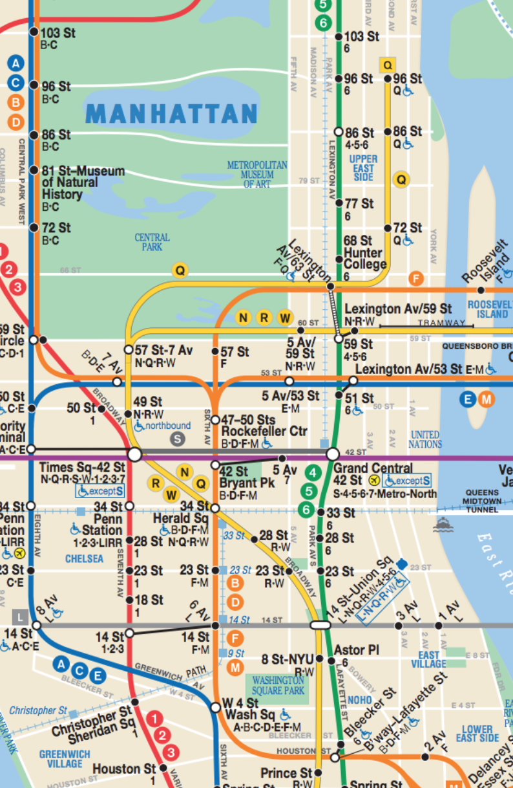
Executive summary
Focus resources on high traffic stations and times
Consider demographics and proximity to tech centers alongside raw MTA ridership numbers
Notes:
BRAD DAVIES:
Ridership dips Sat/Sun. Focus on weekdays
Demographics – Morning Commute, Tech Centers – Evening Commute
Mention map: these are the recommendations that we suggest, and my colleagues will go into that in more depth

Slide 6
Approach
Compute total entries per station entrance by time of day
Morning Target: Weight entries by demographics
Working women
Education
Median income
Evening Target: Filter by tech business centers
Notes:
KEVIN STERN:
Because you want to mobilize in the next 3 months, we used Q1 2017 data to best optimize street teams
First, we used the MTA dataset to construct raw entries by time of day (4 hour intervals). We saw that the morning and evening rush hours had the highest traffic
Talk about data sources
ACS – social & economic characteristics
Tied ACS data to the location of the subway entrances
Why this is used only to weight the morning commute
Tech Business Center Filters
We filtered our entry data by neighborhood that have a high concentration of tech businesses
Why this is used to filter the evening commute
the number of entrants for each station in each 4-hour period.
▶️ Example: Grand Central-42 St. clocked ~27k entries on 3/31/17 between noon-4pm.
Pinpoint optimal subway stations based on greatest number of entries for the target demographic
Assumptions:
Target wealthy, educated women

Slide 7
Insights

Slide 8
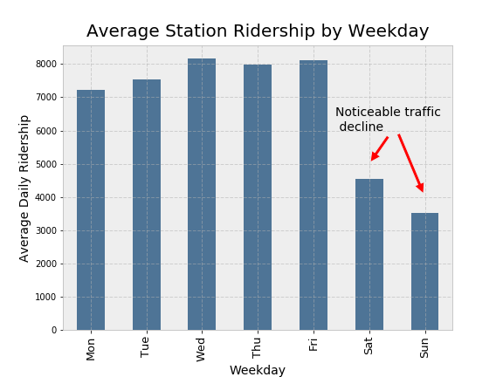
Notes:
Brad Solomon:
As kevin highlighted, there is a noticeable decline in entries on the weekends, so we decided to focus our analysis during the weekdays (M-FRI)

Slide 9
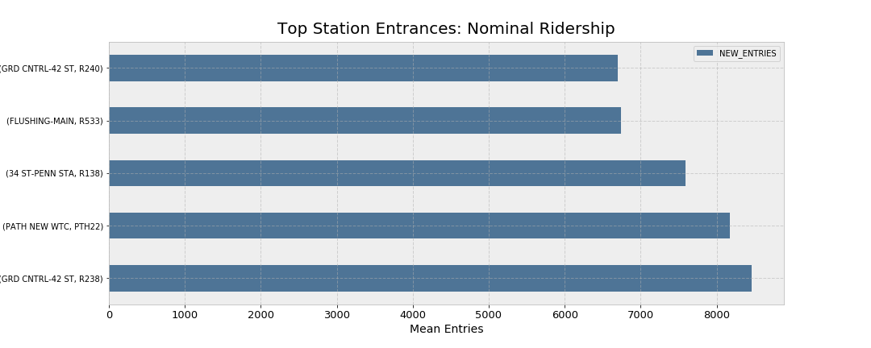
Notes:
Brad Solomon:
Big 3: Grand Central, WTC, 34 St Penn Station

Slide 10
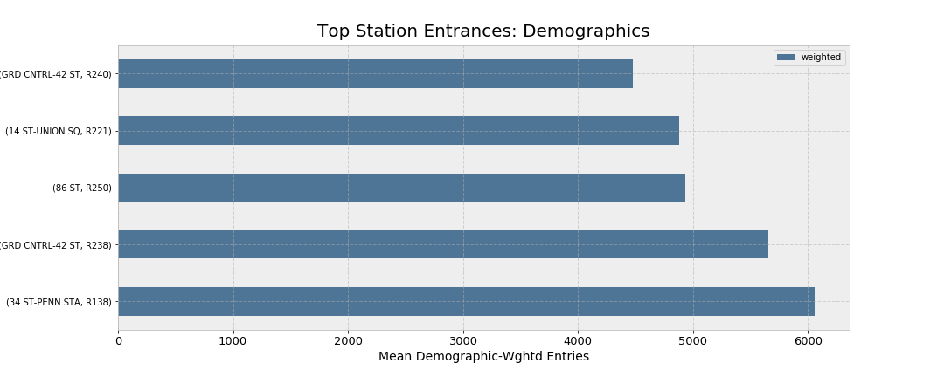
Notes:
Audrey Baker:
This is the bar chart that gives us the attractive scoring station entrances, weighted by demographic scoring. Our scoring takes into account the % of women in the workforce, education level, and income. This is relevant for entrances because this is the neighborhood where people live.
We see some repeats – high ridership and highly ranked on the demographic score
14 st and 86 st pop up in this graph because they performed well enough in the nominal ridership, and were in the top quartile for our demographic weighting.
Ex: 86th street is in the 89th percentile of our scoring, while it’s ridership is the top quartile
**We considered midnight – 8am only for these attributes**

Slide 11
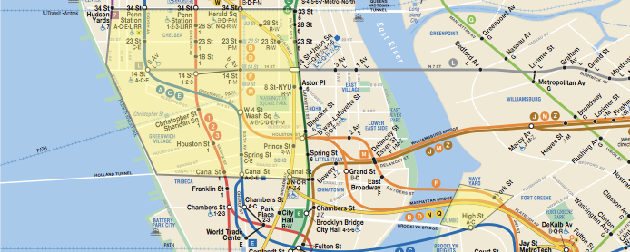
Tech business centers of NYC
Notes:
Audrey:
As kevin mentioned before, we did this analysis by filtering our entry data by neighborhood that have a high concentration of tech businesses.
We applied this filter onto our nominal subway entry information

Slide 12
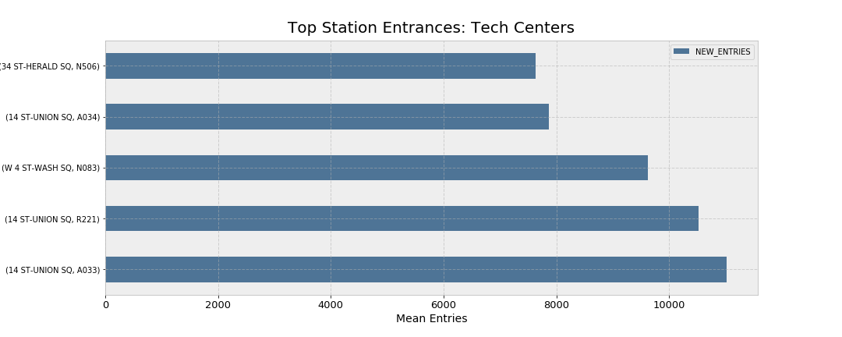
Notes:
Audrey Baker:
Only focusing on stations within the tech centers shown in the previous slide.

Slide 13
Recommendations
Notes:
Brad Solomon:
We would like to give you a quick visual overview of our recommended subway stations (or focal points)

Slide 14
Morning focal points
34 St – Penn Station
42 St – Grand Central
86 St
Notes:
Brad Solomon:
These appear in demographically attractive areas that have high ridership numbers

Slide 15
Evening focal points
14 St – Union Sq
W 4 St – Wash Sq
34 St – Herald Sq
Notes:
Brad Solomon:
We target these areas in ”silicon alley” in an effort to capture the evening commute of the tech workforce

Slide 16
Questions?

Slide 17
Appendix

Slide 18
Data quality issues
Implausible "jumps" in implied ridership*
Arbitrary "resetting" of ridership counts
Duplicated entries
Timeslot demarcations not aligned with morning hour
Poor field documentation (lack of clarification on field hierarchy)
* On 1-22-17 at 12:00:00, the 14th St 01-03-00 turnstile (N078 R175 ACEL) had 8,476,560 cumulative entries. The next recorded entry figure was 2,130,669,389 cumulative entries, 4 hours later at 16:00:00, implying a 4-hour difference of 2.1 billion riders. ~25 such cases.
* On 1-22-17 at 12:00:00, the 14th St 01-03-00 turnstile (N078 R175 ACEL) had 8,476,560 cumulative entries. The next recorded entry figure was 2,130,669,389 cumulative entries, 4 hours later at 16:00:00, implying a 4-hour difference of 2.1 billion riders.
* On 1-22-17 at 12:00:00, the 14th St 01-03-00 turnstile (N078 R175 ACEL) had 8,476,560 cumulative entries. The next recorded entry figure was 2,130,669,389 cumulative entries, 4 hours later at 16:00:00, implying a 4-hour difference of 2.1 billion riders.

Slide 19
Detecting “true flukes” (not outliers)
As mentioned earlier, we find ~25 entries that can be deemed “unrealistic” and are removed from the dataset. (25,000+ entrants to one turnstile within 4 hours.)
However, we also find “legitimate” entries where 4-hour entry tallies are as high as the 2,500-3,500 range. (3,500 turnstile entrants in 4 hours would imply 1 entrant every 4.11 seconds.)

Slide 20
Field hierarchy
LINENAME
STATION
C/A
C/A
UNIT
UNIT
UNIT
UNIT
SCP
SCP
SCP
SCP
SCP
SCP
SCP
SCP
Split-apply-combine:
Find total entries at 4-hour intervals at the turnstile (SCP) level.
Aggregate back up to the station level (LINENAME/STATION/CA).
~2.3 million turnstile + timeslot records
Notes:
Alternate names: UNIT == REMOTE; CA == BOOTH.

Slide 21
Data sources
Core dataset:
~2.3 million records (turnstile+time pairs).
Spanning Jan 7, 2017 thru Mar 31, 2017.
Discrete differences @ 4hr intervals. (0:00, 4:00, …)
External datasets leveraged to find stops with favorable demographic concentrations:
Subway Census Tract Data.
2012-16 American Community Survey 5-Yr Estimates

Slide 22
Demographic weighting
Percentile-rank each station by it’s locale’s:
Composite education score (pct. associates degree or above);
Proportion of females in population;
Median income
Areas with missing data are assigned their field-wise median
Each station’s final score is an average of the three ranks; nominal entry figures are weighted by these scores to target demographically attractive areas.

Slide 23
A note on memory usage
We reduce the memory footprint of our raw dataset by a factor of 3.5x, from 783.60 MB to 224.12 MB through use of categorical datatypes and integer downcasting.
Pandas pd.categorical dtype maps raw values to integer values, using an optimized int subtype but retaining unique representation.
Notes:
https://pandas-docs.github.io/pandas-docs-travis/categorical.html#memory-usage

